Slide 1
CWRUded
Jacob Alspaw

Slide 2
Who am I?
St. Louis, MO
CWRU Student
5th Year in Computer Science w/ focus in Software Engineering
Graduate this spring
Experience doing mobile and web development
I have an idea that I’d like to show all of you

Slide 3
What’s the problem?
Waiting Sucks
Nobody likes walking into an overly-crowded place, whether it’s a gym, library, or dining hall
CWRU has no good way to gauge how busy campus buildings are without going to one yourself
Many students have to deal with these inconveniences ex1: dinning hall has very limited seats ex2: KSL has very limited seats ex3: No room in the gym to workout
End up wasting time
Is there a good solution?

Slide 4
Inspiration
Waitz
UCSD
A direct quote from a student on UCSD campus: "Waitz ... has a huge presence on campus"

Slide 5
Introducing CWRUded
Pronounced “crowded”
A service that allows its users to see how busy areas are in real-time, saving them time and frustration
Enables users to “know before they go”
CWRUded will report the real-time "busyness" for locations around campus
It does this by estimating how many people are in a general location at any point in time
Takes a per-building approach

Slide 6
Where would we put this service?
Carlton Commons
Fribley
Nord
Sears
A.M. Medical Library
Kelvin Smith Library
Tink
Thwing
Wade
Starbucks on E115
Veale
Wyant
Think[Box]

Slide 7
How can campus benefit?
Improve upon student-life greatly by allowing students to plan ahead of time
Eliminate the inconvenience of arriving to a campus building only to find that it’s packed
Will save students time and frustration

Slide 8
How it works
Estimates how many people are in a general location
Passively listening to network traffic in the location
No network scanning involved as of now
Aggregates a set of distinct and “relevant” devices
If a device has not been active recently (i.e the device has likely left the location) then they will be dropped from the list
From these results, we can derive an estimate for how busy a certain location is in real time

Slide 9
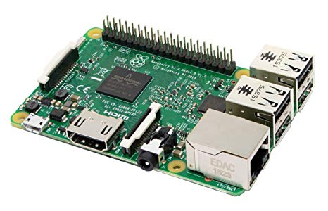
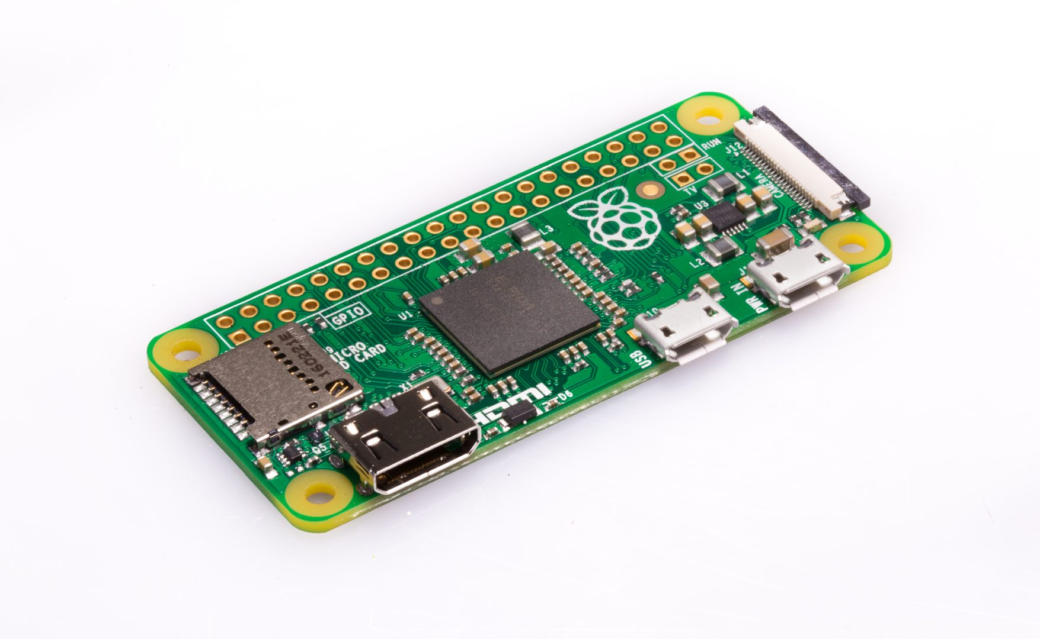
Sensor Options

Slide 10
Application explained for a single sensor
C program
Promiscuously reading in packets sent over the wireless network (libpcap)
For packets with unrecognized MAC Addresses
caches a hashed version of the packets’ MAC addresses
And keeps track of the time the packet was processed
For packets with recognized MAC Addresses
Update the time that the MAC Address was last seen
MD5, SHA-1, SHA-2 ?
No processing whatsoever of packet payload, only header data. Payload is discarded as soon as it is received

Slide 11
Application explained for a single building
Server-client (or server-sensor) relation among many Raspberry Pis
1 server per building to manage all data collected by the sensors throughout the building
Server collects cached information collected by our sensors and aggregates the results
Server is responsible for occasionally clearing out stale devices from the cached results
Sensors will publish cached information to servers using MQTT (a simple IoT connectivity protocol)
Why use many devices per building?
Allows for better coverage of the buildings wireless network
Can capture and process more data which ensures better reliability

Slide 12
Application explained for all buildings
Main node.js server that is responsible for storing the results of all buildings and exposes a RESTful API that will be helpful later
Each building’s server will post a number of active devices that the sensors detected recently in that area. Main server stores the results into a database, one row per building
Outside applications then use RESTful API to gather real-time information

Slide 13
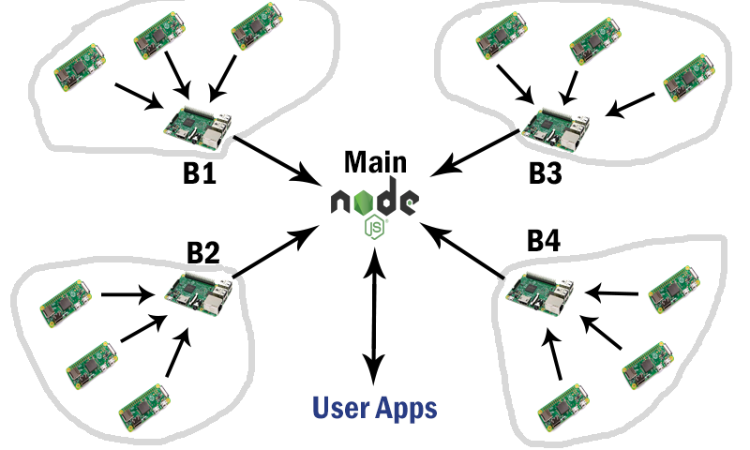

Slide 14
Aggregating Results Further Explained
How accurate are results?
Measuring the number of users on a wireless network is often unreliable
Getting an exact number is near impossible by passively listening
Requires network users to be actively sending data
But we don’t care about exact numbers!
Estimates are good enough to measure how busy a location is
We just need to compare the estimated number of devices to a predetermined expected number of devices. If the estimate is higher than the expected, then we know that a location is busy

Slide 15
Data Privacy
No packet payload processing
MAC Addresses are anonymized during hashing when they are cached. Therefore we are not tracking the movements of people around campus
MQTT has options for authentication and authorization policies that we can use when anonymized MAC Addresses are sent to a designated building server

Slide 16
Planning over the next few months
I have the basics working on my home network
Need to start testing different approaches on campus network
Make changes that will give the best possible solution
Then deploy services to campus (website, IOS, Android)
Improve more with user feedback
Testing
Refinement
Deployment
Refinement

Slide 17
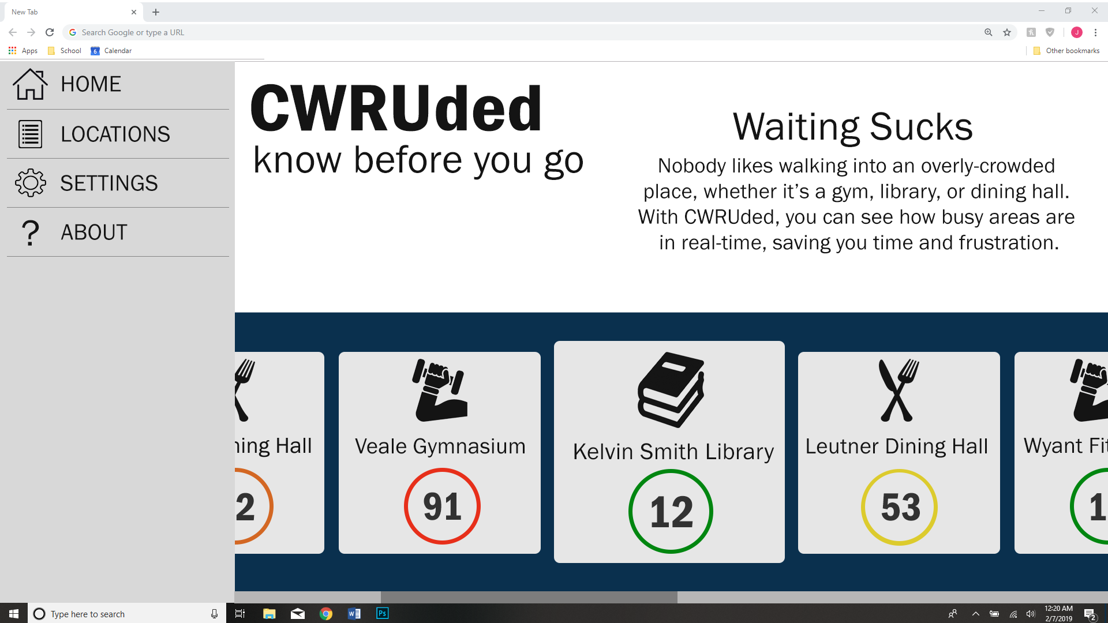

Slide 18
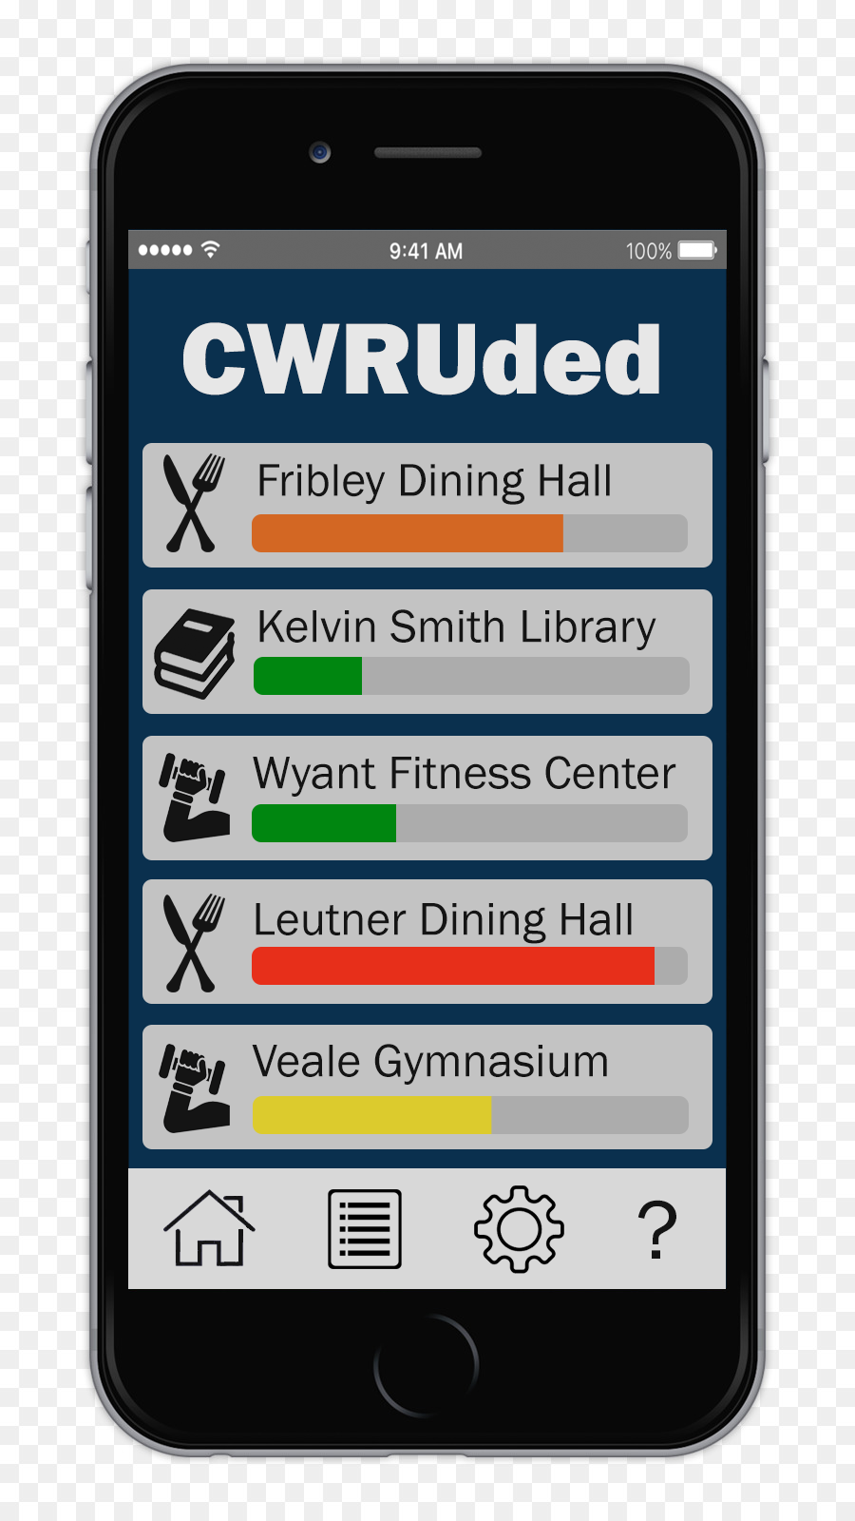

Slide 19
Costs
Supplies
WiFi dongles ($10)
Raspberry Pi Zero W ($10)
Raspberry Pi 3 ($30)
Maintenance
Sensors
Servers
Website / Apps

Slide 20
What do I need right now?
Is this something U[Tech] is interested in?
Permission from the department to test on campus network
Supplies
If possible, storage / work area

Slide 21
Questions?

